Slide 1
The Development of Sound Waves Students’ Worksheet Integrated with Augmented Reality Program to Increase Students’ Critical Thinking Skill
Nadya Damayanti, uny

Slide 2
background
Augmented Reality
Kurikulum Nasional
Sound Wave
Interactive Learning Media
Students’ Worksheet (LKPD)
Students’ critical thinking skills
Abstractionism
Memorization
Contextualism
Match Focus

Slide 3
Methods
Group | Pre-test | Treatment | Post-test
Experiment 1 | O₁ | X | O₂
Experiment 2 | O₁ | Y | O₂
Control | O₁ | Z | O₂

Slide 4
Critical Thinking Skills indicators
Elementary clarification
Basic support
Interference
Advance clarification
Strategy and tactics

Slide 5
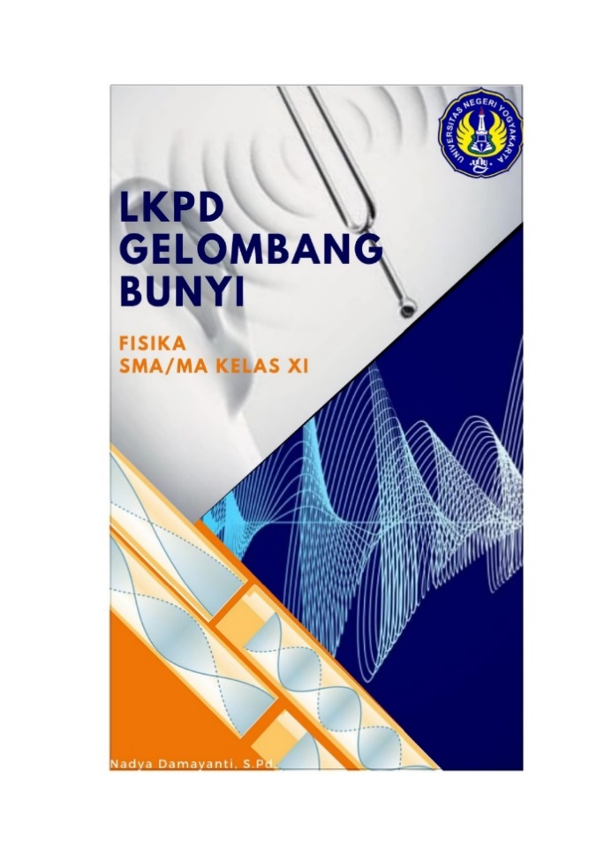
Products

Slide 6
results
Material aspect | Feasibility | Category
Learning process | 3.12648378 | Good
Learning material | 2.863486073 | Good
Language | 2.777028904 | Good
Mean | 2.951394 | Good
Media Aspect | Feasibility | Category
Media Design | 3.061528602 | Good
Software | 2.488875 | Moderate
Usability | 3.246114383 | Good
Mean | 3,045878 | Good
Items | 1 | 2 | 3 | 4 | 5 | 6 | 7 | 8 | 9 | 10
Aiken’s V | 0.812831 | 0.804757 | 0.804757 | 0.789441 | 0.804757 | 0.812831 | 0.797111 | 0.804757 | 0.789441 | 0.804757

Slide 7
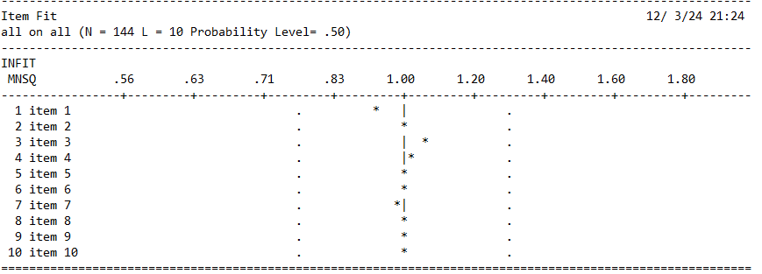
Results
Summary of item | 0,69
Summmary of case estimates | 0,71

Slide 8
Results

Slide 9
conclusion
Products are feasible
Products have significant impact

Slide 10
Thank you

