Slide 1


Research Presentation
Developing a Multimodal Electronic Module for English Structure Learning at Higher Education
PRESENTED BY:
Prof. Dr. Afrianto Daud, M.Ed.
Universitas Riau

Slide 2

I
Research Background
Rapid technological advancements require updates in instructional strategies and resources [1-3].
Blended learning is promoted in higher education through programs like Merdeka Belajar and Kampus Merdeka (MBKM), encouraging flexible learning [5].
Benefits:
  Accommodates diverse learning styles
  Enhances student engagement and autonomy [6].

Slide 3

II
Research Objectives
Problem: Limited digital resources for blended learning in English Structure courses at Universitas Riau, where grammar comprehension is challenging [17-20].
Research Objectives:
  Develop a multimodal e-module that integrate text, visuals, videos, and quizzes for the Post-Intermediate Structure course.
  Validate the module’s effectiveness through expert feedback.

Slide 4





III
Methodology
The study follows the ADDIE model:
  Analysis
  Design
  Development
  Implementation
  Evaluation
Identified the need for a multimodal e-module for Structure courses.
Planned the module structure, integrating multimedia elements.
Created the e-module with text, images, videos, and quizzes.
Expert validation to ensure quality and relevance.
Testing the module in actual classroom settings: Post-intermediate Structure class.
Students feedback of using the e-module for Post-Intermediate Structure class.

Slide 5
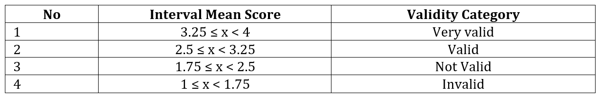
III
Methodology
Focus
Data Collection
This study emphasizes the Develop stage, specifically the expert validation process, to assess the module’s feasibility.
Two experts were asked for the material validation and media validation. The validator assesses multiple aspects using a 4-point scale (1 = very poor or inappropriate, 2 = fairly good, 3 = good or satisfactory, and 4 = excellent).
The validity criteria follow the framework proposed by Sugiyono (2016):

Slide 6




IV
Research Results
E-Module Design
The module covers five topics of English structure: Conditional Sentences, Gerunds, Infinitives, Complex Sentences and Relative Pronouns.
The e-module was created using:
Canva
Youtube
Quizizz
Publuu
To create the module from scratch and the learning videos
To upload the learning videos
To create interactive quiz
To publish the final e-module that combined all the multimodal components

Slide 7
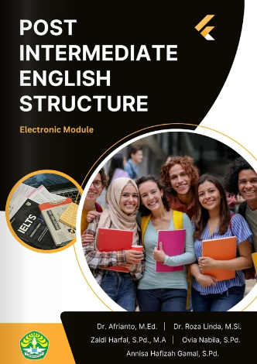
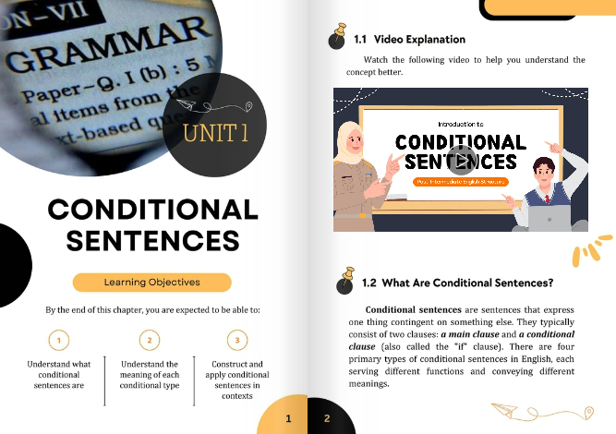
Video explanation linked to Youtube
Explanation
Learning objectives
Cover

Slide 8
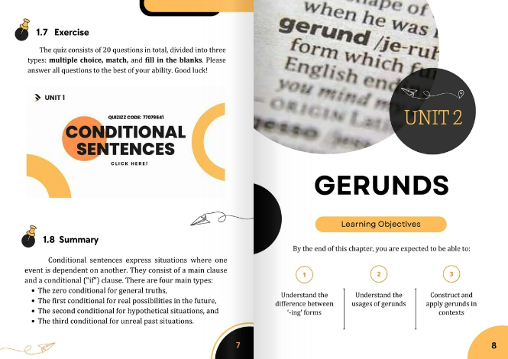
E-Module on Publuu
Interactive Quiz, linked to Quizizz
Summary

Slide 9
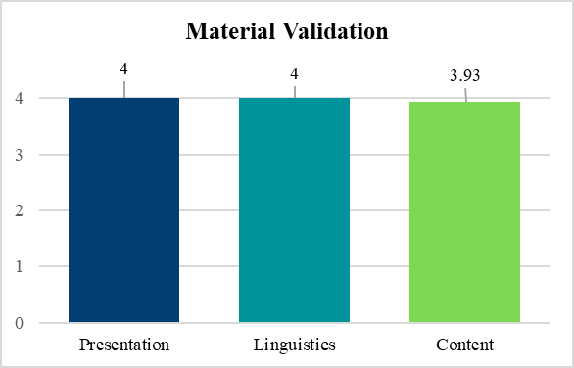
IV
Research Results
Experts Validation Result:
Material Validation
Three aspects were assessed: Presentation (4/4), Linguistics (4/4), Content (3.93/4).
The average of material validation is 3.97 which is categorized as Very Valid. This result shows that the e-module rated highly across content, presentation, and linguistics, confirming alignment with learning goals.

Slide 10
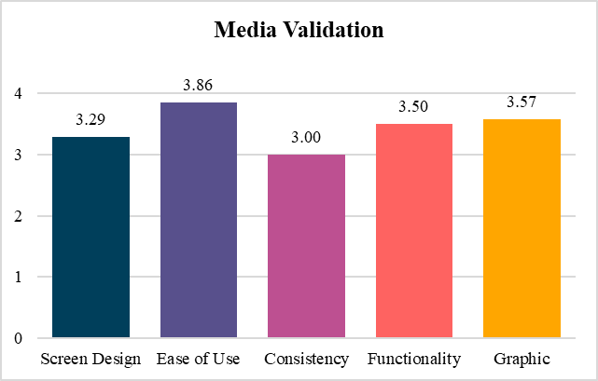
IV
Research Results
Experts Validation Result:
Media Validation
Five aspects of media validation: screen design (3.29/4), ease of use (3.86/4), consistency (3/4), functionality (3.50/4), and graphics (3.57/4).
The average of material validation is 3.44 which is categorized as Very Valid, ensuring ease of use and engagement. The media aspects of the e-module was revised based on the validation result.

Slide 11
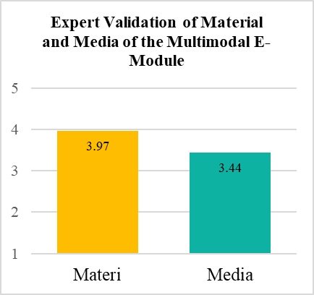
IV
Research Results
Experts Validation Result:
Overall Validation
The overall result suggests that the multimodal-based e-module developed in this research excels in both the quality of its material and media elements.

Slide 12
V
Conclusion
  The validated multimodal e-module effectively meets the needs of post-intermediate Structure courses, enhancing students’ learning experience in blended environments.
  It supports student engagement and autonomy in English grammar learning, addressing gaps in digital resources for English education at Universitas Riau.

Slide 13

The End
Thank you
for listening

