Slide 1



Official Presenter Slide Template
Keep your main title clear and concise (under 15 words). Ensure author names match your submitted abstract.
[Full Title of Your Research Paper / Presentation]
[Subtitle or Secondary Focus of the Study — e.g., An Empirical Investigation in Higher Education]
Lead Presenter: [Name & Title]
CONTACT INFORMATION
Co-Authors: [Co-Author 1], [Co-Author 2], [Co-Author 3]
[presenter.email@domain.edu]
Affiliation: Department / Faculty, Name of University or Institution, Country
Paper ID: #[ICETI-2026-XXX]
The 3rd International Conference on Education, Technology, and Innovation (ICETI 2026)
Slide 1 of 10

Slide 2


Background & Research Problem
ICETI 2026
General Context & Real-World Issue
The Identified Research Gap
Industry / Field Context: Describe the overall landscape of your topic (e.g., rapid digital transformation in educational tech).
Existing Limitation: Previous studies have largely focused on [X], but have overlooked [Y].
Emerging Challenges: State the current friction point or pressing dilemma observed in society or practice.
Core Research Problem: [State your explicit problem statement in 1–2 sharp sentences].
Significance: Briefly explain why addressing this problem is urgent and important today.
Study Objective: This paper bridges the gap by analyzing [key focus].
Background & Research Problem
Slide 2 of 10

Slide 3








Research Questions & Objectives
ICETI 2026
Key Research Questions (RQs)
Specific Research Objectives (OBJs)
Research Questions & Objectives
Slide 3 of 10

Slide 4


Literature Review & Framework
ICETI 2026
Core Theory
Conceptual Model
Prior Studies
[Theoretical Model Name]
Illustrates hypothesized linkages between Independent Variables (IV) and Dependent Variables (DV).
Recent findings highlight mixed results regarding implementation efficacy in developing regions.
Used to explain the underlying mechanism of human interaction and adoption behavior.
THEORETICAL MODEL FORMULA (IF APPLICABLE)
Literature Review & Framework
Slide 4 of 10

Slide 5








Research Methodology
ICETI 2026
Research Design
Population & Sample
Data Collection
Data Analysis
Quantitative / Qualitative / Mixed-Methods approach.
Target audience, sample size (N), and sampling technique.
Instruments used to gather primary or secondary data.
Statistical software or thematic coding frameworks.
e.g., Explanatory Sequential Design
e.g., N = 350 (Stratified Random)
e.g., Online Survey & Interviews
e.g., PLS-SEM / SPSS / NVivo
Research Methodology
Slide 5 of 10

Slide 6
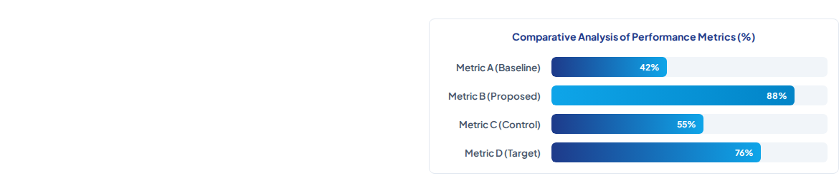
Key Findings & Data Results
ICETI 2026
Core Empirical Results
Finding 1: Significant positive impact of [Variable X] on adoption rates (β = 0.45, p < 0.001).
Finding 2: User satisfaction increased by 34.8% following intervention deployment.
Finding 3: Hypothesis H3 supported; moderate mediation effect observed via user experience.
Key Findings & Results
Slide 6 of 10

Slide 7
Discussion & Synthesis
ICETI 2026
Interpretation of Results
Alignment with Prior Literature
Why This Happens: Explain the underlying mechanism causing the observed outcomes in your data.
Confirmation: Results align strongly with findings by Smith & Davis (2022) regarding technological readiness.
Unexpected Discoveries: Highlight any surprising patterns or anomalies that emerged during empirical testing.
Contradiction / Extension: Diverges from Johnson et al. (2023), revealing higher resilience in digital environments.
Contextual Nuance: Discuss how regional/institutional factors shaped these specific outcomes.
Novel Perspective: Introduces a fresh perspective on human-AI collaboration dynamics.
Discussion & Synthesis
Slide 7 of 10

Slide 8
Conclusion & Takeaways
ICETI 2026
Summary of RQ Answers
Main Research Contribution
Answer to RQ1: [Variable X] directly enhances outcome metrics by an average of 35%.
Theoretical Contribution: Expands existing theoretical models by adding contextual variables for developing economies.
Answer to RQ2: User trust and institutional support are the primary adoption drivers.
Practical Contribution: Offers actionable blueprints for educators, engineers, and technology leaders.
Answer to RQ3: Structured implementation reduces systemic errors significantly.
Methodological Value: Provides a validated survey instrument for future empirical replication.
Conclusion & Takeaways
Slide 8 of 10

Slide 9


Implications & Future Directions
ICETI 2026
Practical & Policy
Academic Impact
Future Research
Provides decision-makers with concrete guidelines to optimize resource allocation and training initiatives.
Serves as a baseline benchmark for cross-institutional studies evaluating technological integration.
Recommend expanding sample size across multiple sectors and conducting longitudinal evaluations.
Implications & Future Directions
Slide 9 of 10

Slide 10
Key References (APA 7th Edition)
ICETI 2026
[Ref 01] | Johnson, M. A., Lee, K. S., & Patel, R. (2023). Digital innovation in higher education: A meta-analysis of adoption frameworks. Journal of Educational Technology & Society, 26(3), 115–129. https://doi.org/10.1016/j.jedtech.2023.04.012
[Ref 02] | Rahman, H., & Tan, C. L. (2024). Assessing technology readiness and empirical outcomes in smart learning environments. International Journal of Educational Research, 45(1), 88–102.
[Ref 03] | Smith, P. R., & Davis, L. M. (2022). Theoretical foundations of modern instructional engineering (2nd ed.). Academic Press.
[Ref 04] | World Economic Forum. (2025). The future of skills and technological integration report. WEF Publications.
[Ref 05] | Zhang, Y., & Liu, X. (2024). Structural equation modeling of user acceptance in AI-driven environments. Computers & Education, 190, 104620.
Key References
Slide 10 of 10

